Slide 1
To include:
For extra points: About MVP (Minimal Viable Product), Ideally if you able show a MVP, will be add on Point. Check on more details here --> https://www.ibm.com/cloud/garage/content/think/practice_minimum_viable_product/
At a minimum (baseline), the teams have to be able to articulate :
the data sources that your proposed apps will need access to (have done research, explored with the data source owners and ensure that there are no policy prohibiting access etc)
projection of cost to develop (resource/time/money)
This to encourage your proposal to be feasible & realistic vs. just being a good idea.

Slide 2
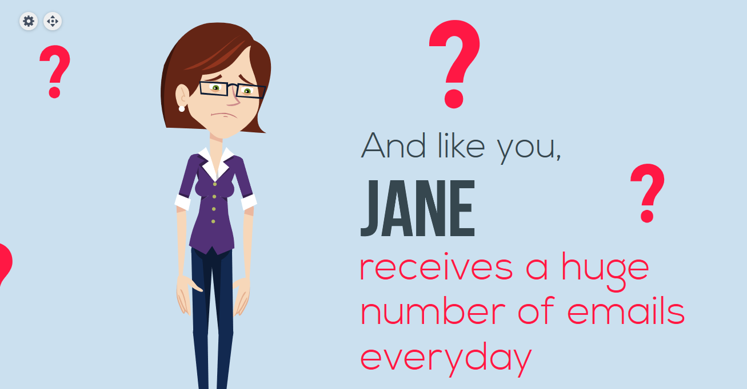

Slide 3
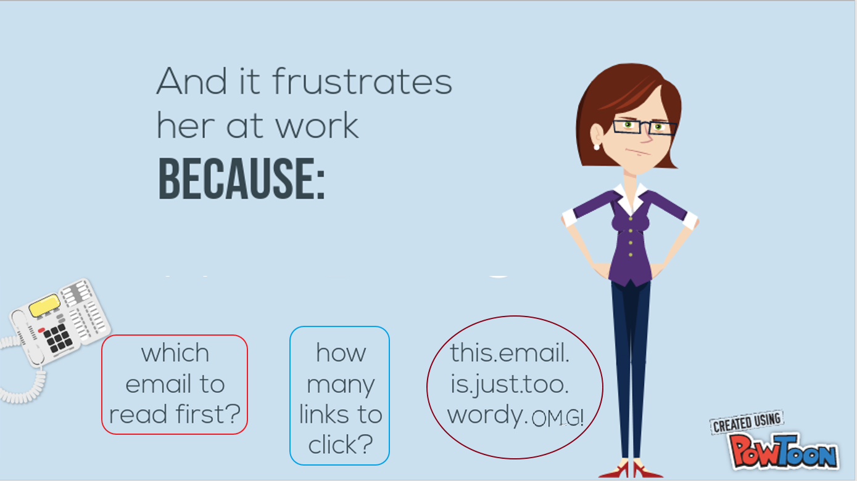

Slide 4
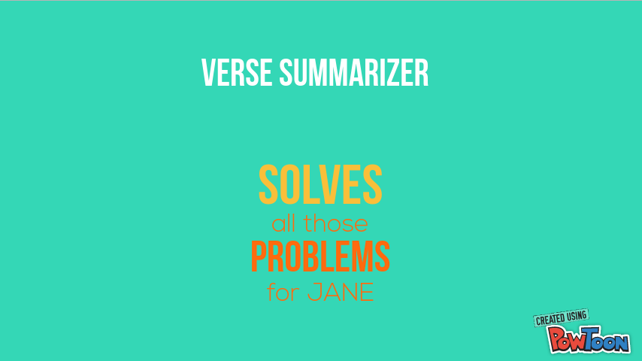

Slide 5
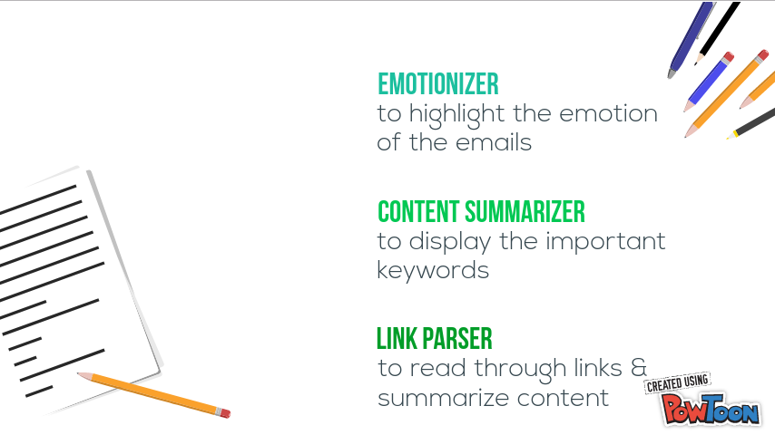

Slide 6
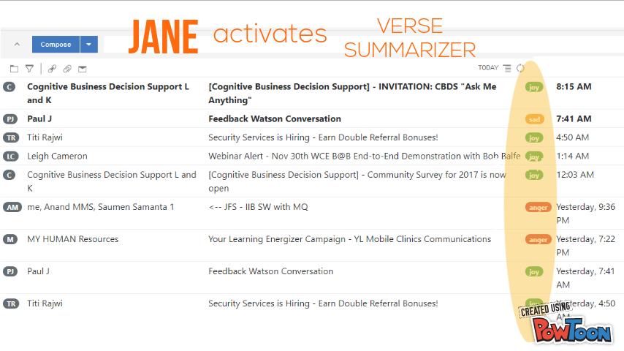

Slide 7
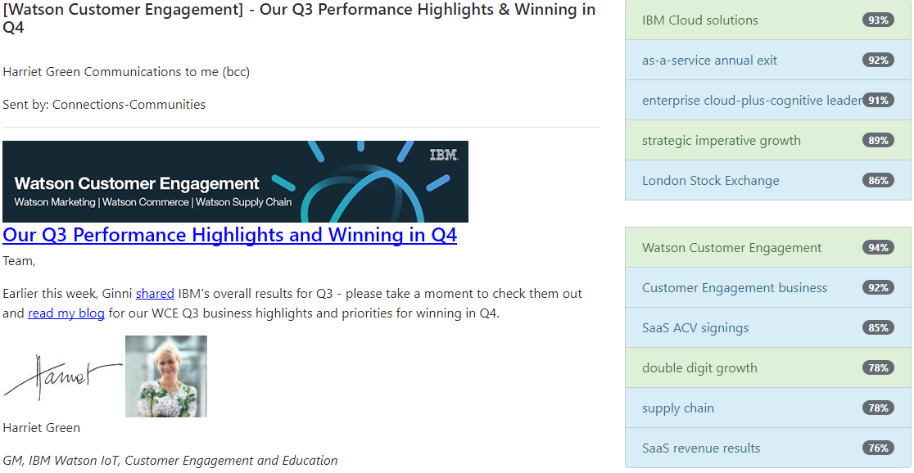

Slide 8
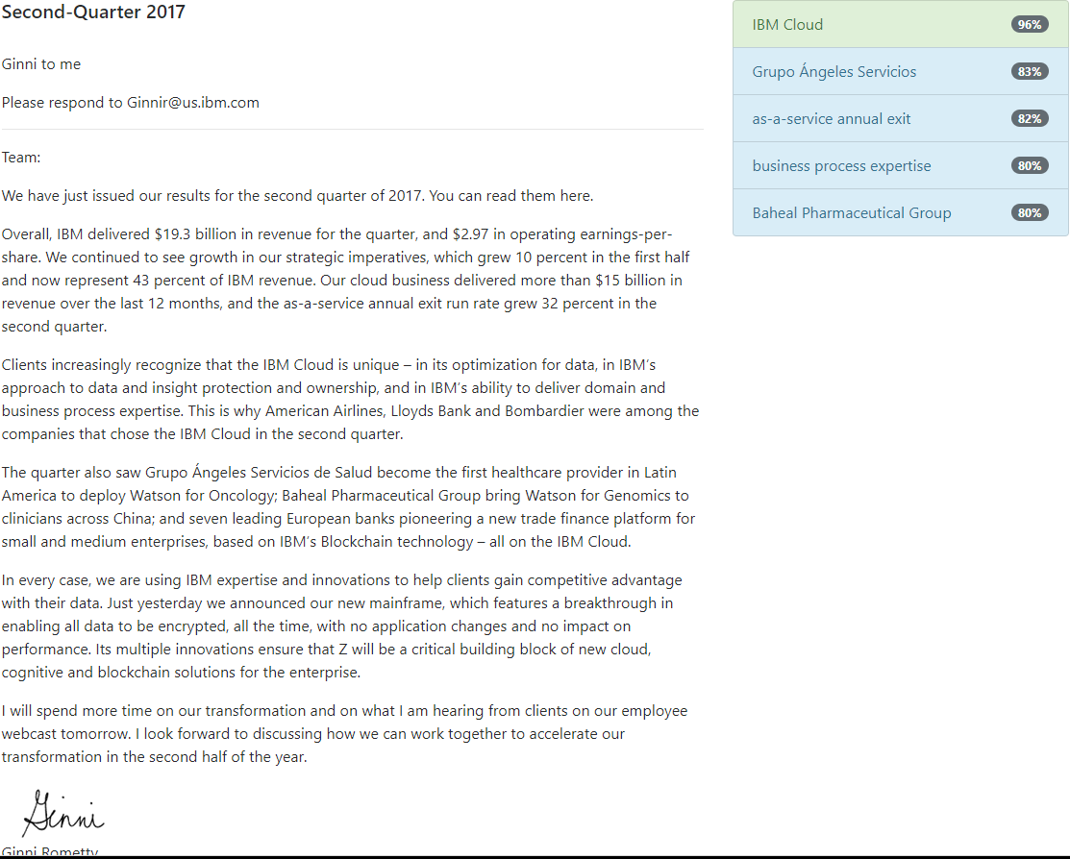

Slide 9


Slide 10
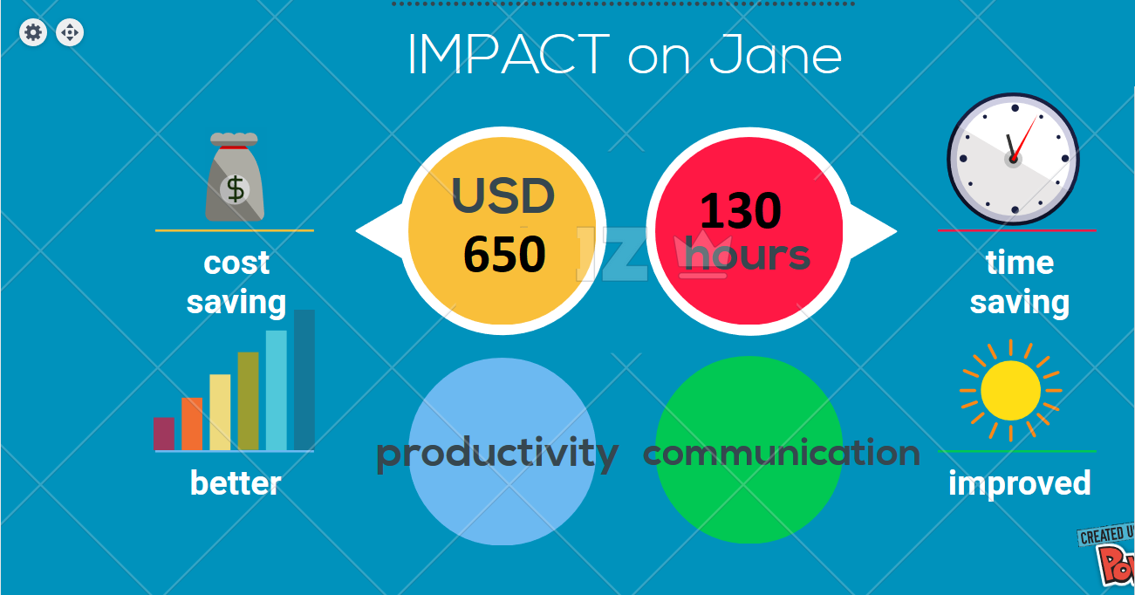

Slide 11


